Slide 1
Analyzing the spread of COVID-19 in Ontario.

Slide 2
Project Members
Dayo Thompson
Kirushan Kirubaharan
Sushant Deshpande

Slide 3
At the end of this report, we will know….
1. Who was affected by the virus?
2. Which regions in Ontario were affected?
3. How was the virus contracted?
4. What roles do weather conditions play in the spread of the virus in Toronto?

Slide 4
Data Sources All data collected from January 23, 2020 to June 30,2020
https://data.ontario.ca
https://www.wunderground.com/history/monthly/ca/toronto
https://www.kaggle.com

Slide 5
1. Data Exploring and Cleanup

Slide 6
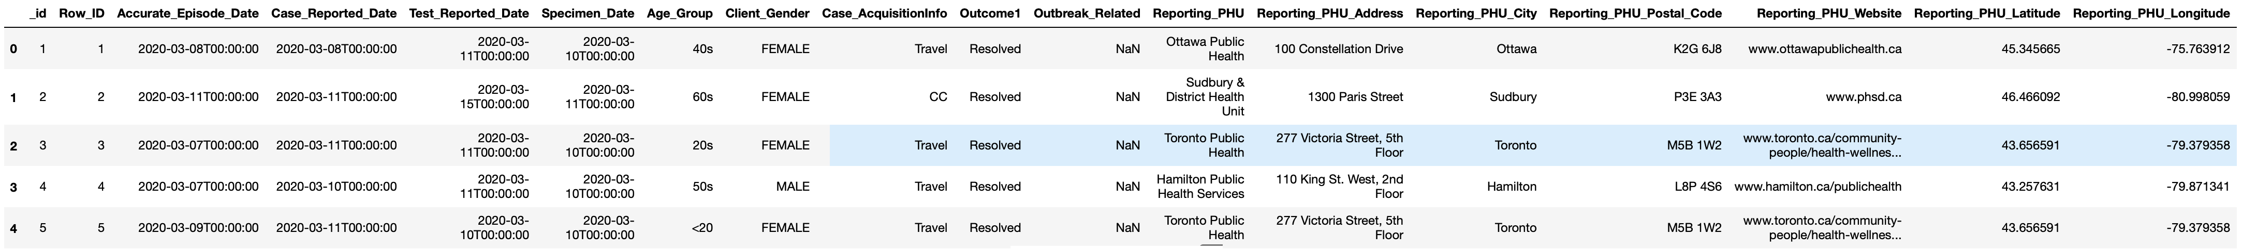
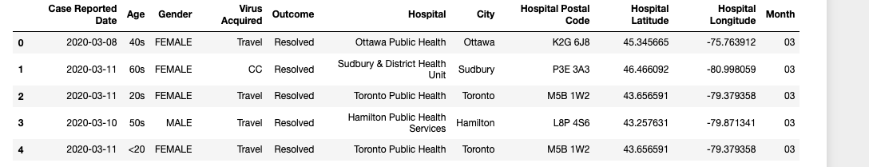
Ontario Dataset (before)
Ontario Dataset (after)

Slide 7
Using the Ontario dataset and Toronto weather dataset, we decided to merge data frames.

Slide 8
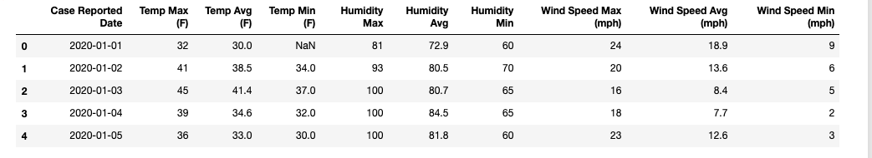
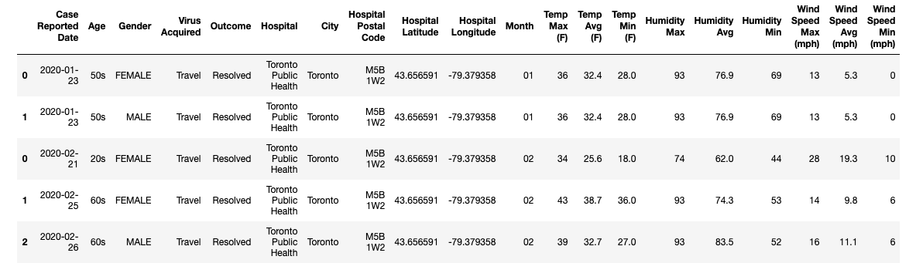
Toronto Weather Dataset (after)
Toronto Weather Dataset (after)

Slide 9
Data Analysis

Slide 10
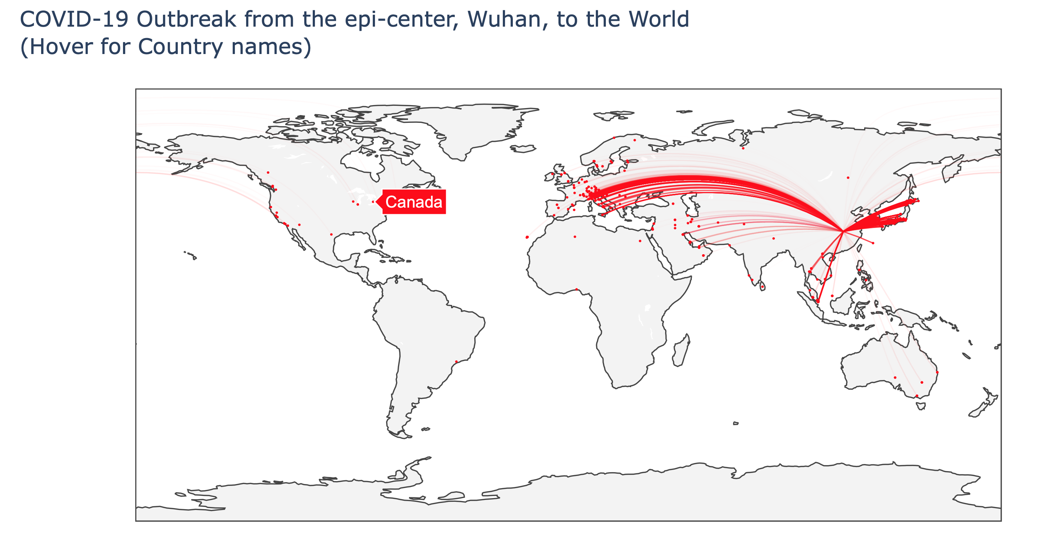
By 24th Feb. 2020, ten travelers had arrived Canada from Wuhan, China. Seven of them landed in British Columbia and three in Ontario. One of the three cases was in London. The other two, both in their 50s, were in Toronto.
Now, let’s look at the numbers in Ontario four months later and a deep dive into weather conditions in Toronto later in this analysis.
10

Slide 11
Which regions in Ontario were affected?

Slide 12
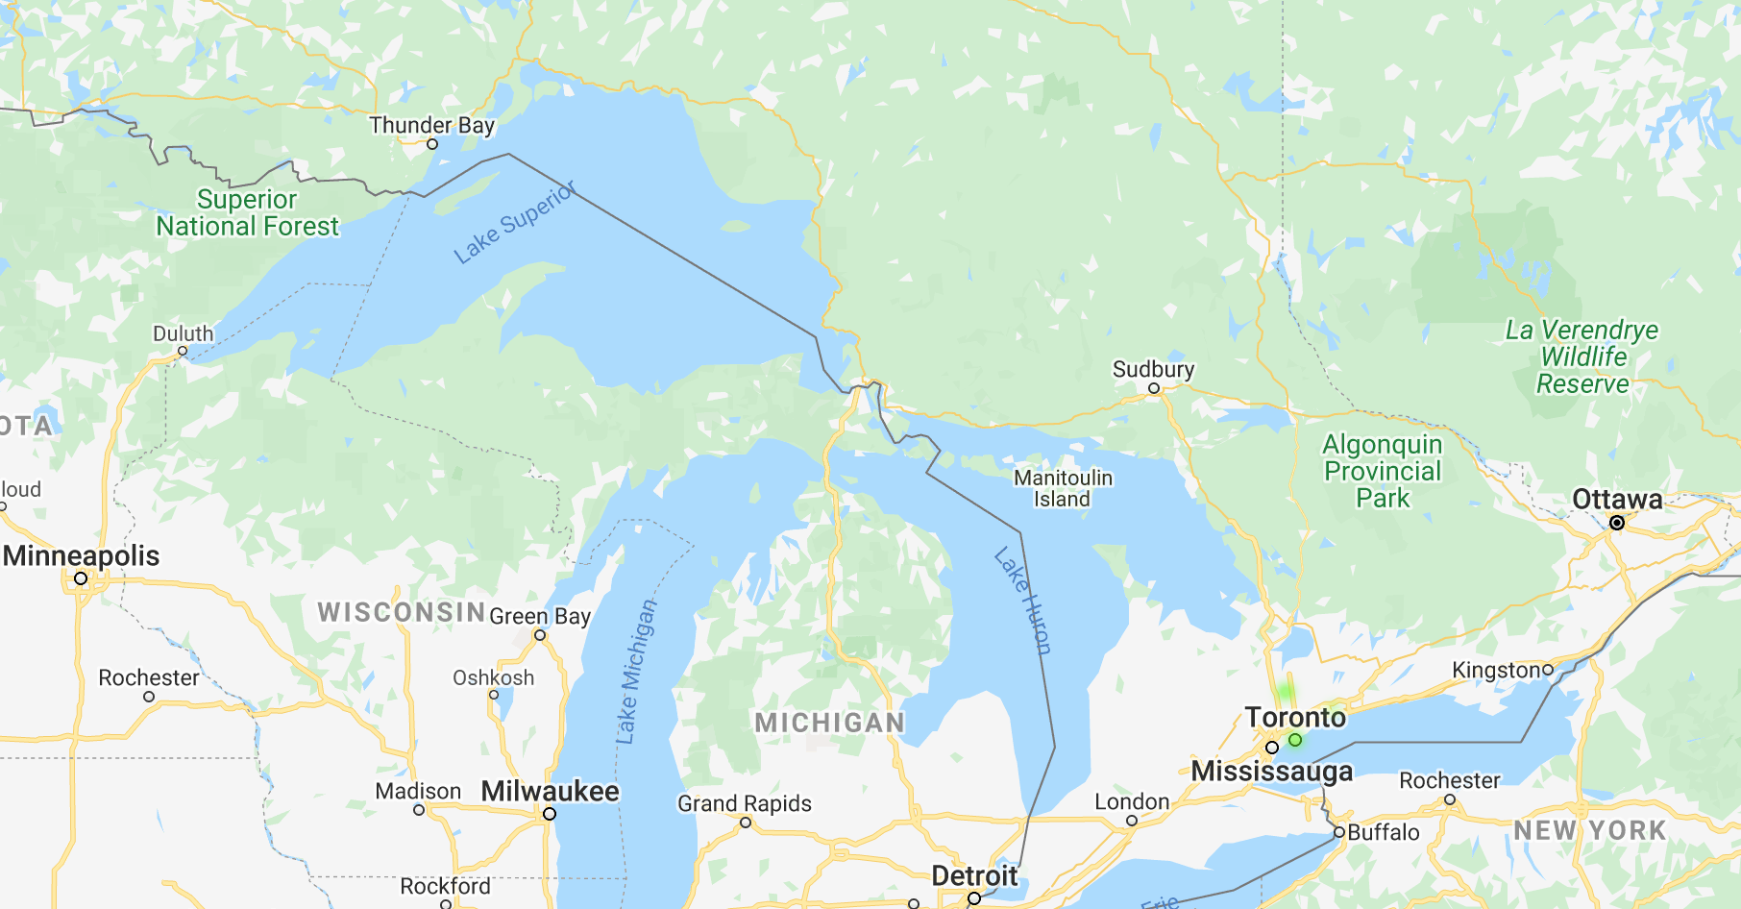
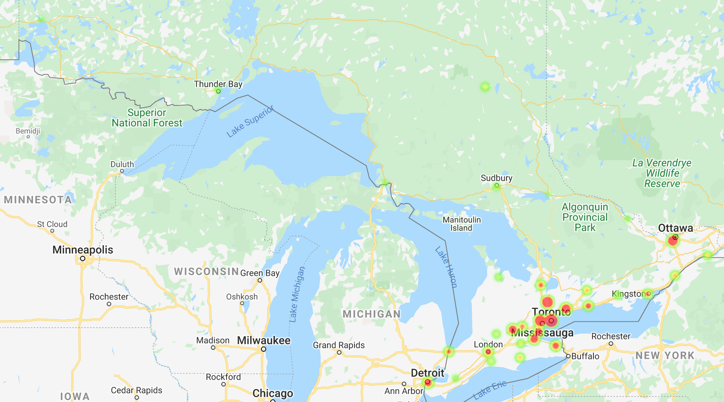
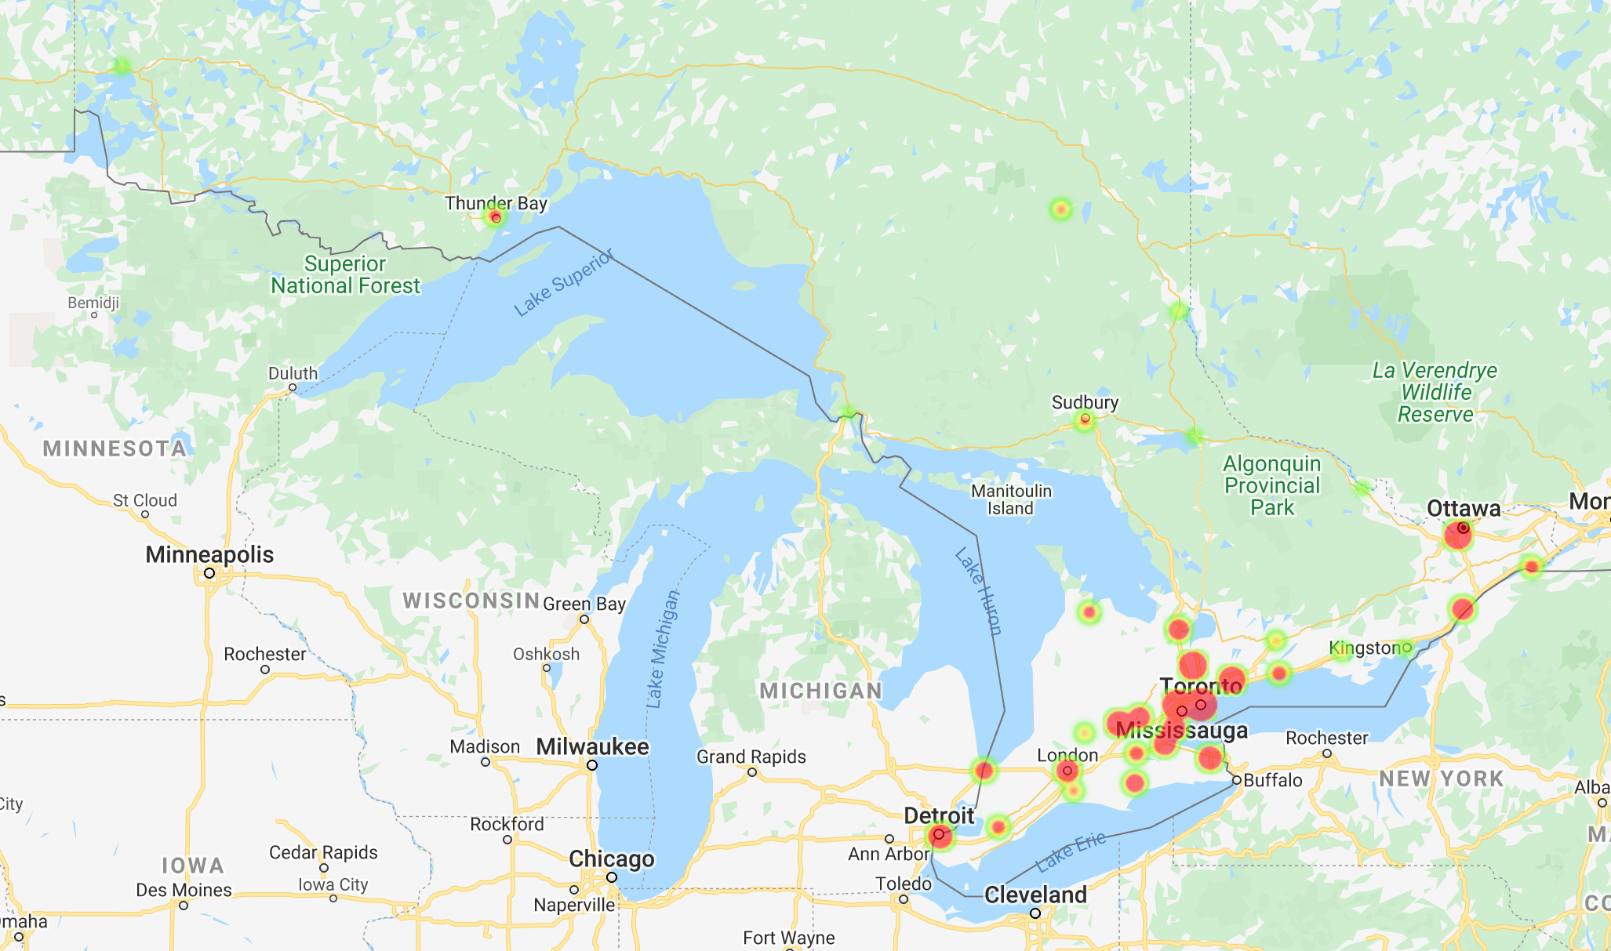
February
March
April
Which regions in Ontario were affected?
12

Slide 13
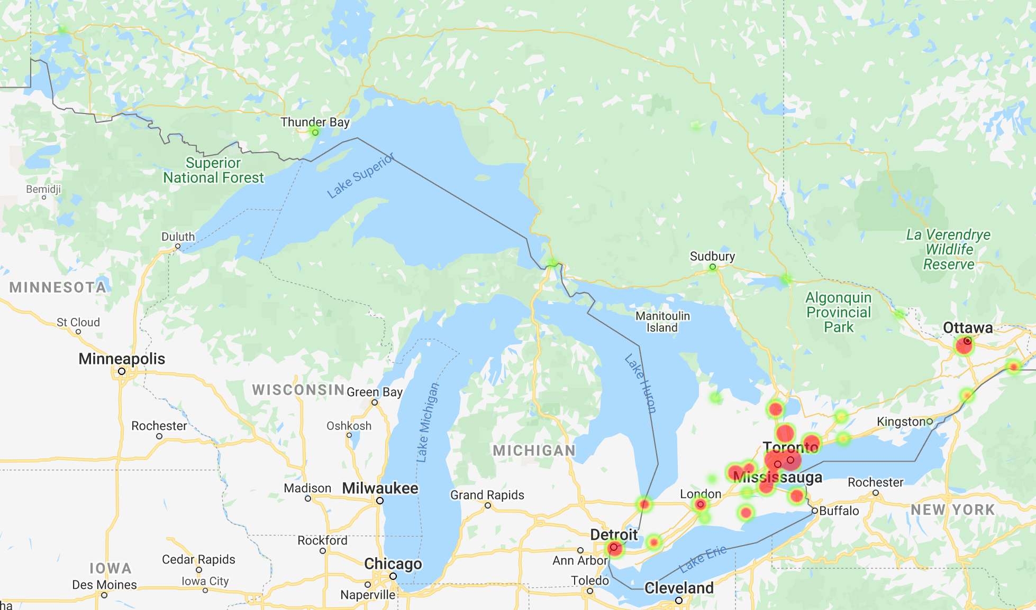
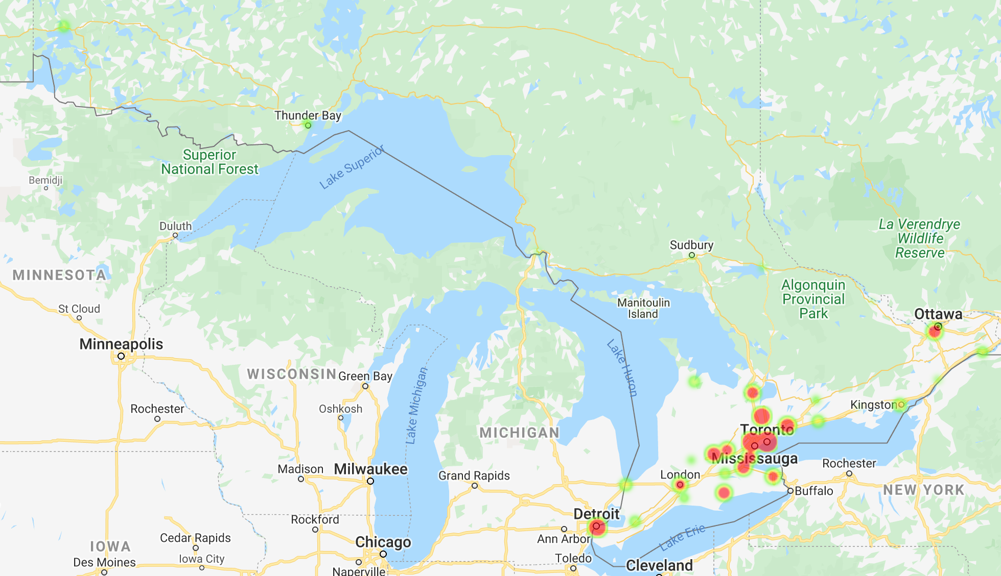
May
June
From April to May, there was a 25% decrease in the number of cases, while from May to June, there was a huge decline of 42% in the number of cases. By the end of June, New Liskeard did not report any cases.
13

Slide 14
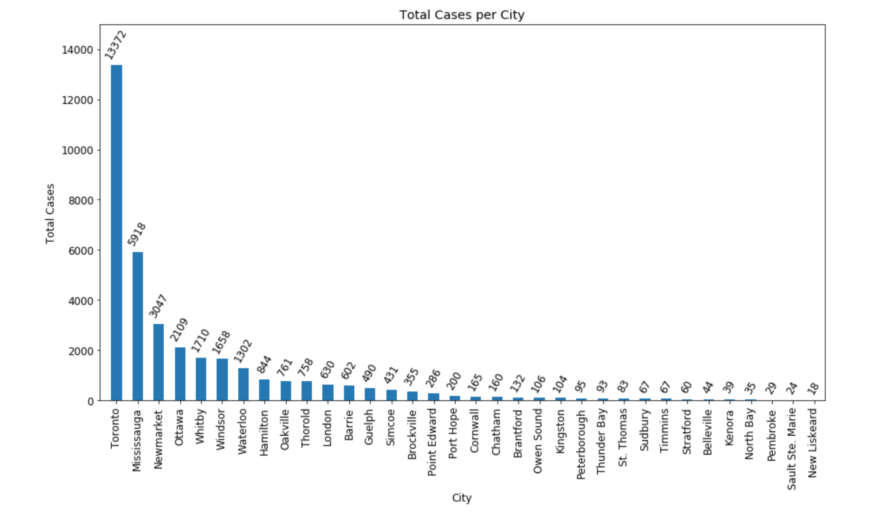
Which regions in Ontario were affected?
14

Slide 15
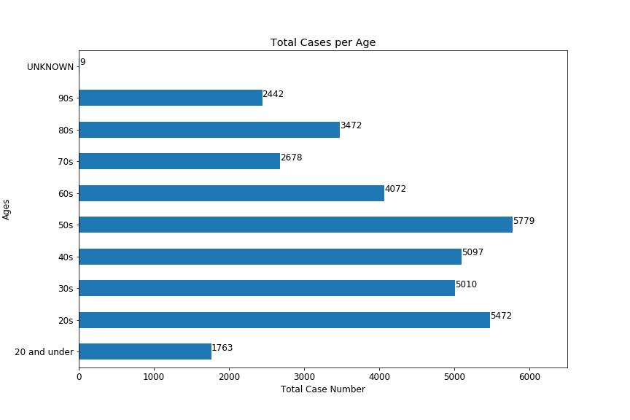
What age groups were mainly affected by the virus?
15

Slide 16
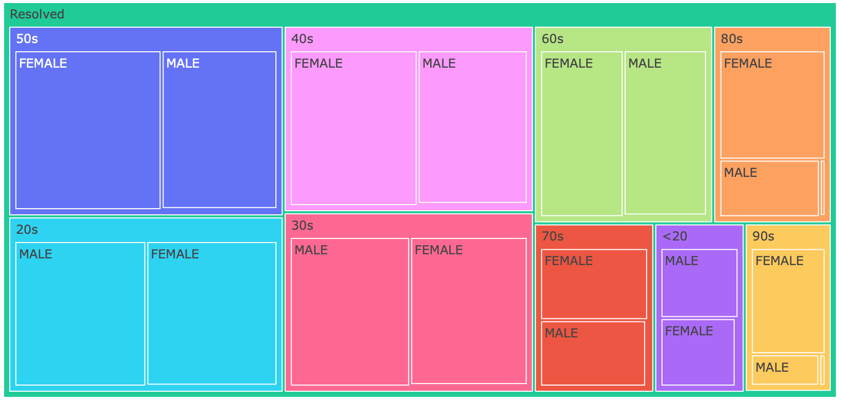
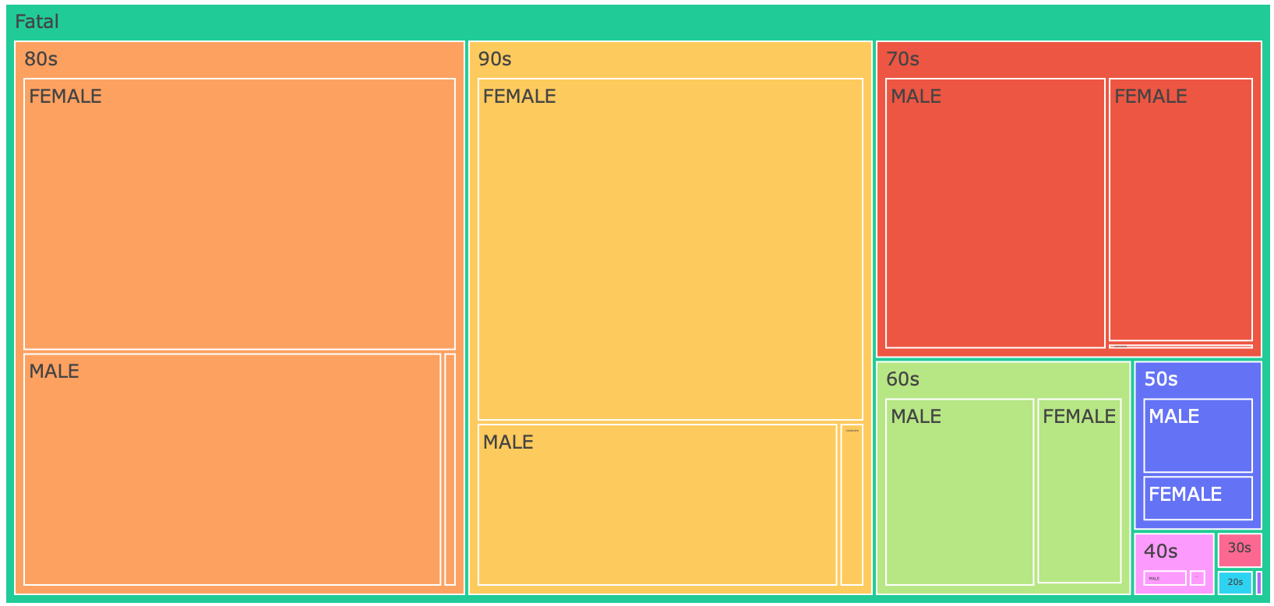
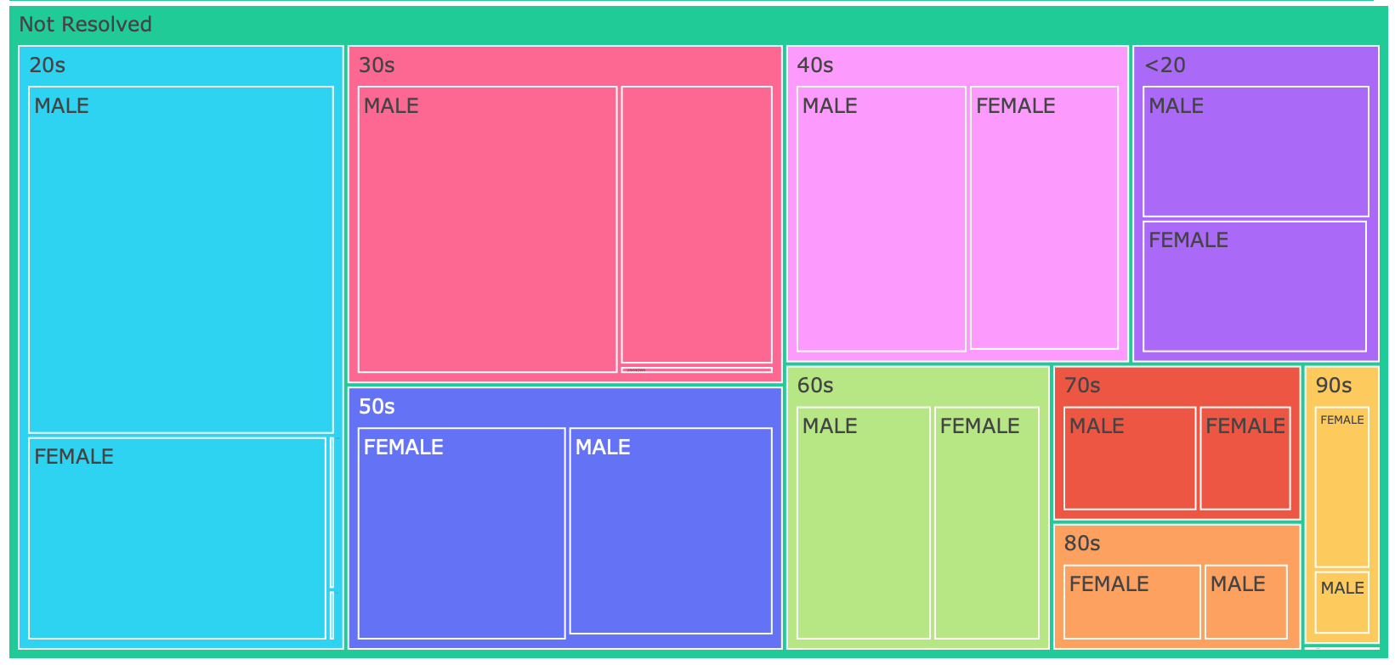
Resolved cases
Fatal cases
Not Resolved cases
Resolved cases – 87.3%
Fatal cases – 7.5%
Not Resolved cases – 5.1%
16

Slide 17
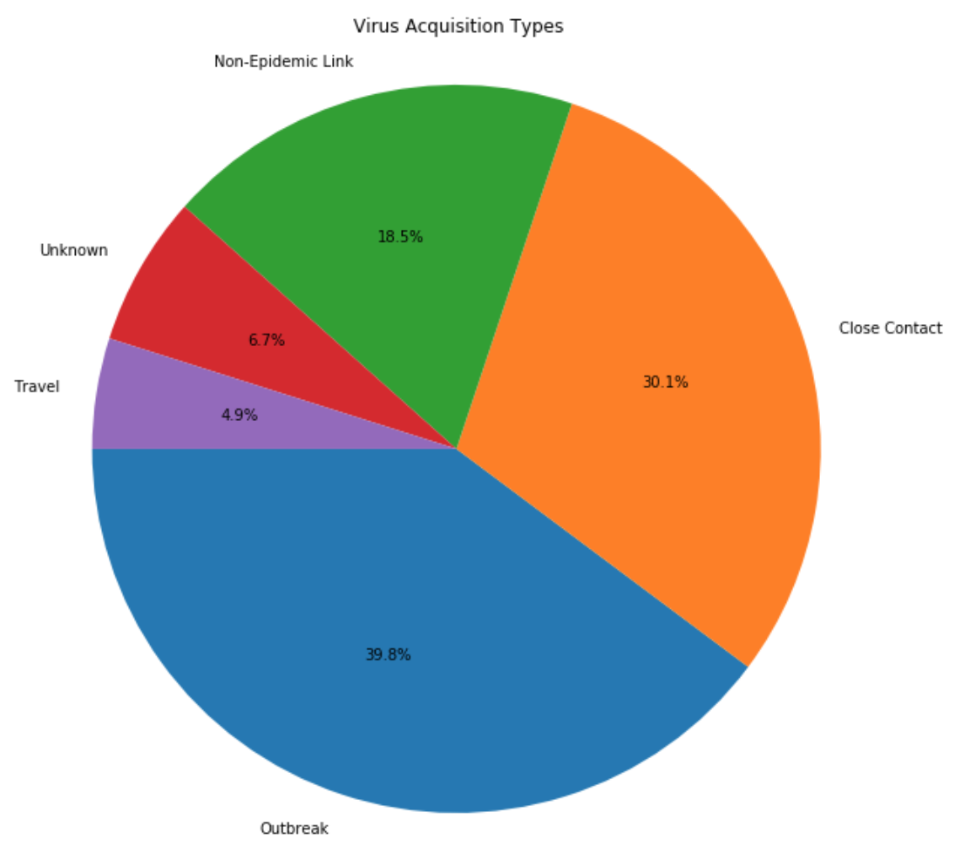
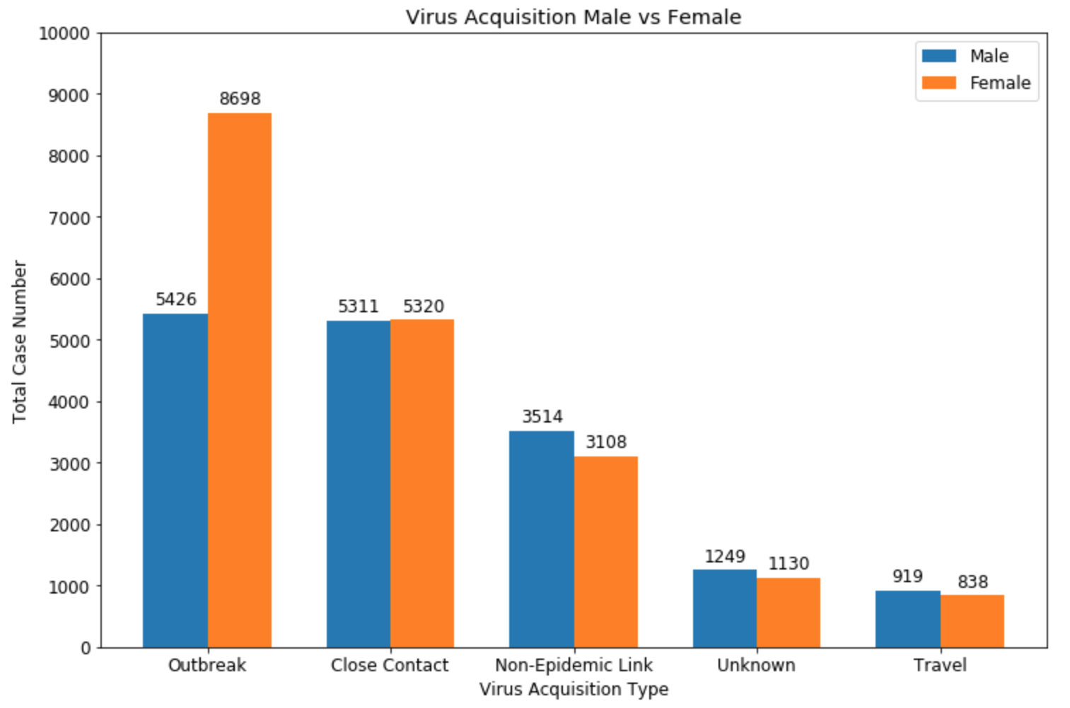
How was the virus contracted?

Slide 18
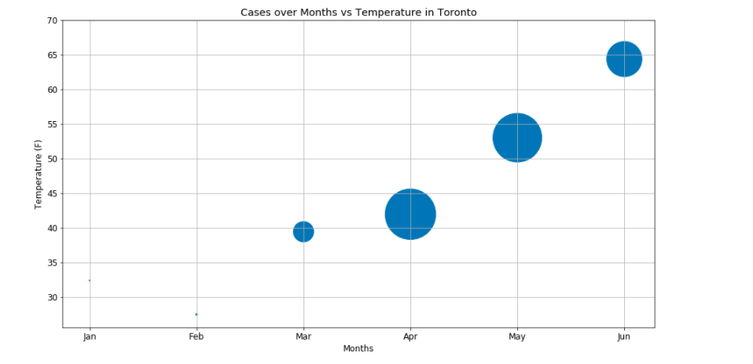
What roles do weather conditions play in the spread of the virus in Toronto?

Slide 19
What roles do weather conditions play in the spread of the virus in Toronto? Case Reported Date vs Wind Speed (mph)

Slide 20
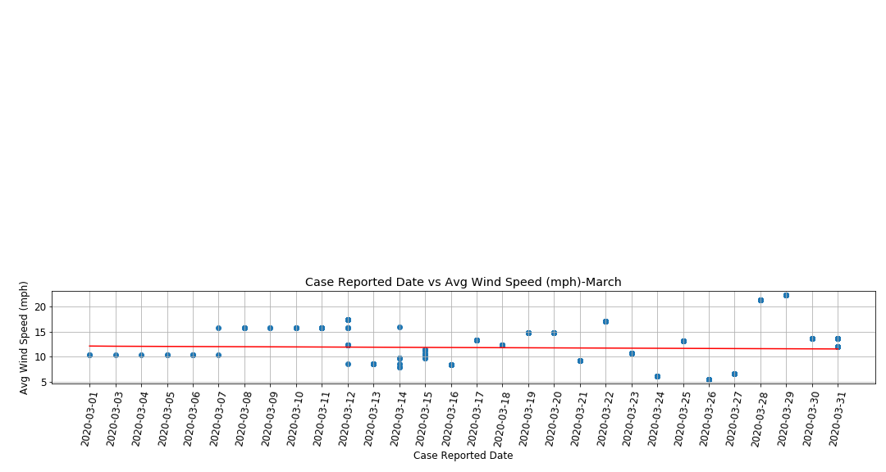
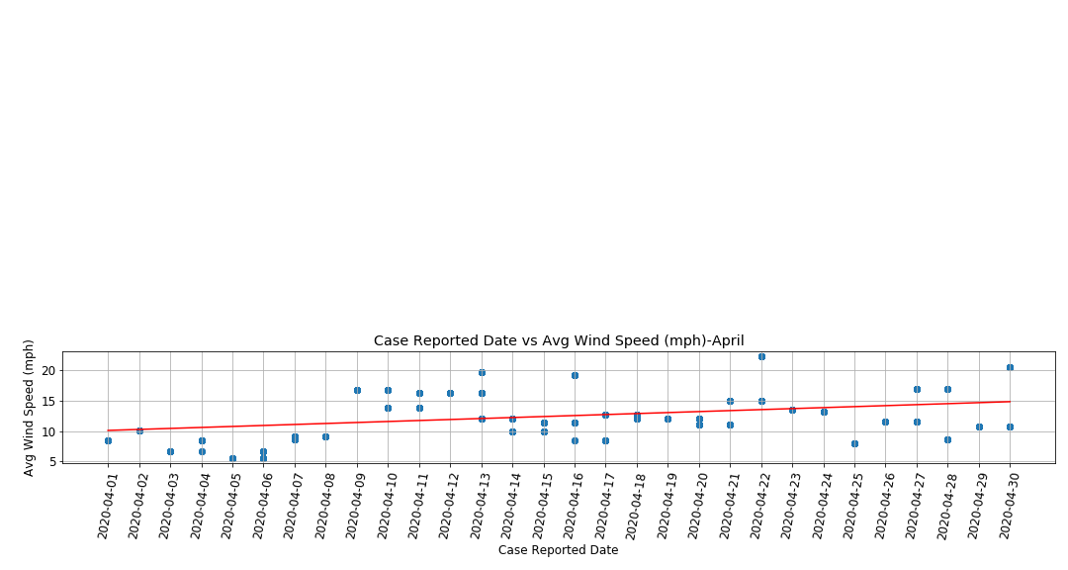
20
20

Slide 21
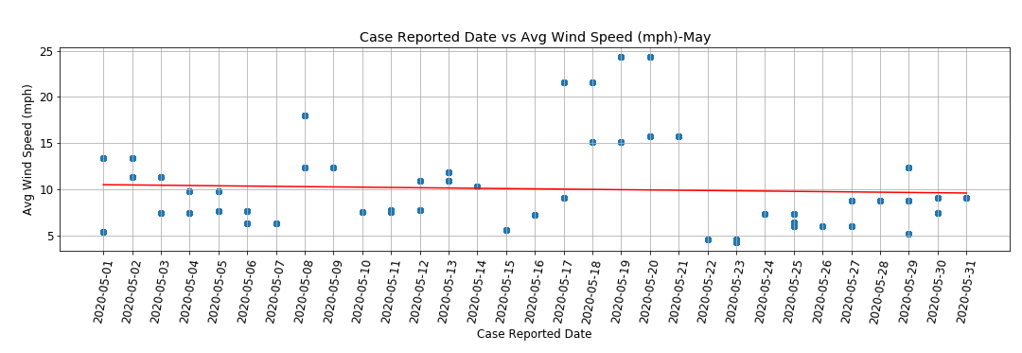
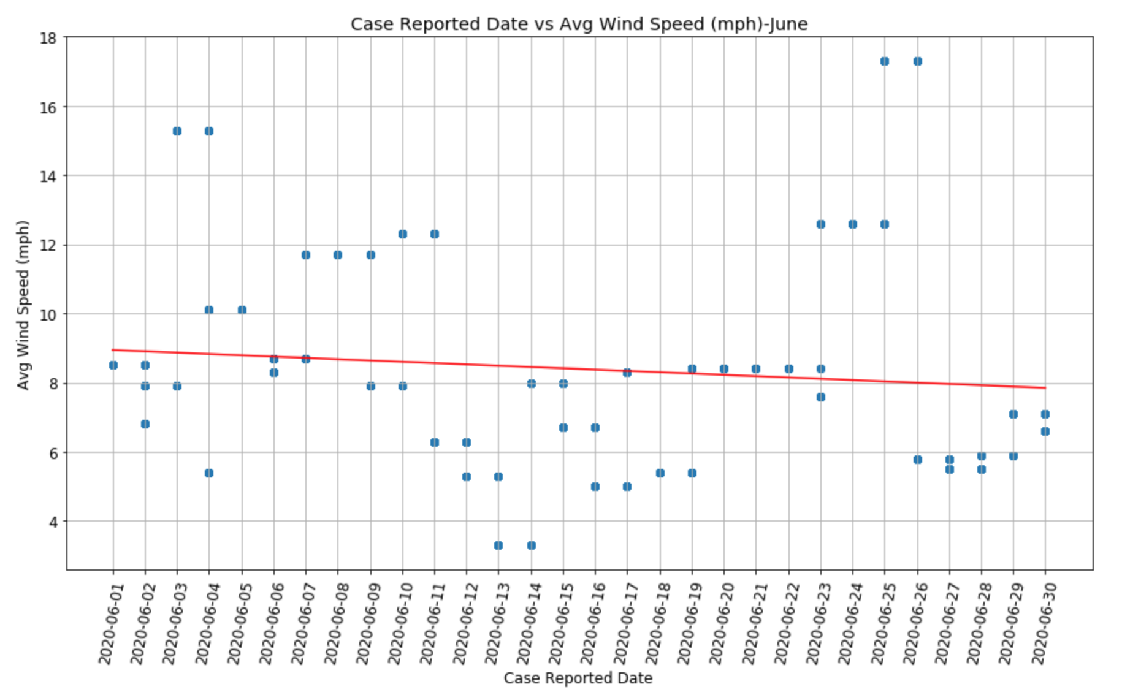
21

Slide 22
Conclusions
In Ontario, major cities were severely impacted including Toronto (largest numbers) and GTA.
April 2020 was the peak spread of the virus as it had the most cases in Ontario.
Females had a higher mortality rate but also a higher recovery rate than males.
Females were mostly contracting the virus through outbreak, while males were mostly contracting the virus through close contact.
Majority of the data shows as the temperature increases over time; total reported cases reduces.
Windspeed does not seem to be a driver that impacts the number of cases in Toronto.

Slide 23
Implications of Findings
Some of the reported cases in Ontario occurred in cities closes to the US borders, suggesting this might have added to the spread.
The most common means of contracting the virus was due to lack of proper precautions.
Largely populated cities are responsible for most of the spread in Ontario.
In February, population was not reporting symptoms as virus was not classified as severe at that time. In March, the virus was considered a pandemic and reported cases increased significantly but started reducing by the end of May and June.
Temperature played a significant role in the decease of total cases.

Slide 24
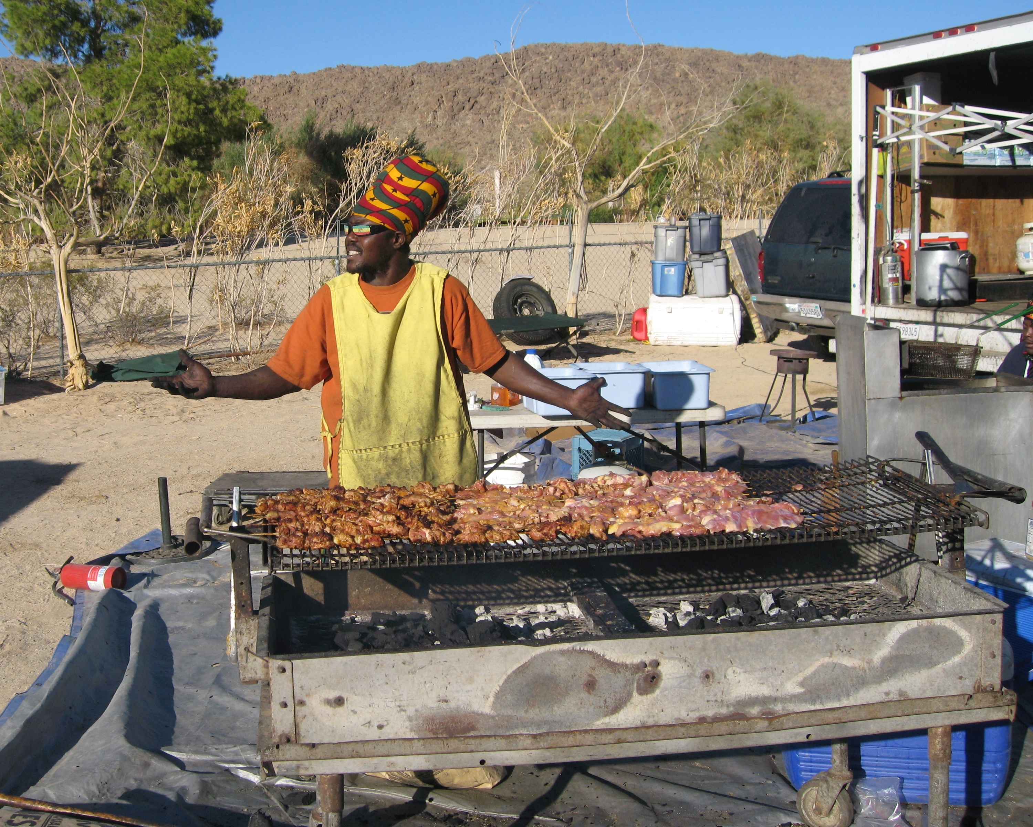
Thanks to the datasets discovered, we were able to create interesting correlations which represents how the Coronavirus pandemic has affected all of us. The current weather has certainly been a factor in the decrease of total cases, so continue to enjoy the summer with caution.

